Slide 1


COFFEE SALES
George Mathew
10th September 2024

Slide 2
Outline
Executive Summary
Introduction
Methodology
Results
Conclusion

Slide 3
Executive Summary
Summary of methodologies
Data Collection through csv file downloaded using link for Exploratory Data Analysis and prediction.
Data Wrangling after converting into Pandas data frame and sampling data and dealing with Nulls. And convert certain data types.
Exploratory Data Analysis for time series analysis and specific customer purchases and preparing data for ML model to predict sales.
Machine Learning Pipeline to predict sales.
Summary of all results
Exploratory Data Analysis result
Predictive Analytics result

Slide 4
Introduction
Project background and context
This dataset contains detailed records of coffee sales from a vending machine.
The vending machine is the work of a dataset author who is committed to providing an open dataset to the community.
It is intended for analysis of purchasing patterns, sales trends, and customer preferences related to coffee products.
Data Collection Period :
The dataset spans from March 24 onwards and has captured daily transaction data.
Task - 1
Carry out Time series Exploratory Data Analysis
Task - 2
Predict Next day/week/month sales
Task - 3
Predict Specific customer purchases

Slide 5
Section 1

Slide 6
Methodology
Executive Summary
Data collection methodology:
Data was collected using the download link provided.
Perform data wrangling
Wrangling done using Sampling data and dealing with Nulls,
Perform exploratory data analysis (EDA) using matplotlib
Perform predictive analysis using linear regression models
By preprocessing, allowing us to standardize our data and train-test_split, allowing us to train split our data into training and testing data. It appears that we need to find hyperparameters and determine the model with best accuracy.

Slide 7
Data Collection and its Presentation
Data was collected using the download link provided.
Import the Libraries
Inspecting Data: Check the types and initial content.
Wrangling done using Sampling data and dealing with Nulls.
Extracting Information: Create new fields like the last four digits of the card number.
Data Type Conversion: Convert fileds viz. date and datetime fields etc. to the appropriate types.
Aggregating Data: Carry out different calculations viz. total money spent etc. for analysis.

Slide 8
EDA with Data Visualization
Bar Graphs: ​
Coffee-name-wise Sales
>> After plotting the graph, we observed that the highest sales value contribution is made by “Americano with milk’ closely followed by ‘Latte’ and then by ‘Cappuccino’, ‘Americano’, ‘Cortado’, ‘Hot Chocolate’, ‘Cocoa’ and ‘Espresso’ in that order.
The graph gives an idea of the customer preferences which can be understood better by analysing the customer-wise coffee-name preferences and the count of coffee-name-wise sales.
Coffee-name-wise number of Sales
>> After plotting the graph, we observed that the highest number of sales contribution is made by “Americano with milk’ followed by ‘Latte’ and then by ‘Cappuccino’, ‘Americano’, ‘Cortado’, ‘Hot Chocolate’, ‘Espresso’ and ‘Cocoa’ in that order.
The price of ‘Latte’ being a tad higher than ‘Americano with milk’, value wise although the ‘Latte’ comes close but number of sales-wise there is a distinct gap. Similarly, the price of ‘Cocoa’ being a higher than ‘Espresso’, value wise although the ‘Espresso’ comes after ‘Cocoa’ however, on-the-basis-of number of sales-wise the order is reversed.

Slide 9
EDA with Data Visualization
Bar Graphs: ​
Weekday-wise Sales
>> After plotting the graph for a sample period of 15th March to 21st March 2024, we observed that the highest sales value-wise was made on “Saturday’ closely followed by ‘Wednesday’ and then by ‘Tuesday’, ‘Thursday’, ‘Monday’, ‘Friday’ and ‘Sunday’ in that order.
The graph gives an idea of the days on which the sales are more. The reasons for variation which is apparently large can be understood better by analysing other parameters.
Weekday-wise Sales by Coffee type
>> After plotting the graph for a sample period of 15th March to 21st March 2024, we observed that the day-wise preferences varies as the highest number of sales contribution is made by Americano on Monday while it is by Cotrado on Saturday. And on Tuesday is Latte.
The graph gives an idea of the days on which the sales are more for a particular type of coffee. The reasons for variation can be understood better by analysing other parameters.

Slide 10
EDA with Data Visualization
Line Graphs: ​
Sales Vs Dates​
>> On observing the line plot chart, we see that it is non-linear and there is lot of variation in daily sales over the various dates. While the maximum sales on a day has been 650 (approx.), the minimum sales has been almost zero.
Sales Vs Month
>> On observing the line plot chart, we see that it is non-linear and there is lot of variation in monthly sales during various months. While the maximum sales has been in the month of May 24, the minimum sales has been in April 24.
Scatter graph: ​
Actuals Vs Predicted values​ for Next Day/Week/Month Sales AND Specific Customer Purchase
>> On observing the graph, drawn after applying the linear regression model in respect of the sales prediction for next day/week/month, we see that the points in the graph do not follow any specific pattern giving ground to a thought that the model is not a good fit.
>> On observing the graph, drawn after applying the linear regression model in respect of the specific customer-wise sales prediction for any day-of-the-week/month, we see that the points in the graph do not follow any specific pattern giving ground to a thought that the model is not a good fit.

Slide 11
Predictive Analysis
Summarize how you built and evaluated the linear regression model for Next Day/Week/Month Sales Prediction
BUILDING MODEL
Load our dataset into NumPy and Pandas
Prepare features and target
Split Data into training and testing sets
Initialize the linear regression model
Train the model on the training data
Make predictions on the test data
EVALUATING MODEL
Check accuracy for the model
Calculate Mean Squared Error (MSE) and Root Mean Squared Error (RMSE)
Perform cross-validation and Calculate mean cross-validated MSE
Plot residuals and Plot actual vs predicted values
IMPROVING MODEL
Feature Engineering
FINDING THE BEST PERFORMING CLASSIFICATION MODEL
More analysis and trying with other models after feature engineering will help find the good fit.

Slide 12
Predictive Analysis
Summarize how you built and evaluated the linear regression model for Specific Customer Purchase Prediction
BUILDING MODEL
Load our dataset into NumPy and Pandas
Prepare features and target
Split Data into training and testing sets
Initialize the linear regression model
Train the model on the training data
Make predictions on the test data
EVALUATING MODEL
Check accuracy for the model
Calculate Mean Absolute Error (MSE), Mean Squared Error (RMSE) and R square Score
Perform cross-validation and Calculate cross-validated MSE
Plot residuals and Plot actual vs predicted values
IMPROVING MODEL
Feature Engineering
FINDING THE BEST PERFORMING CLASSIFICATION MODEL
More analysis and trying with other models after feature engineering will help find the good fit.

Slide 13
Results
Exploratory data analysis results
Predictive analysis results

Slide 14
Section 2

Slide 15
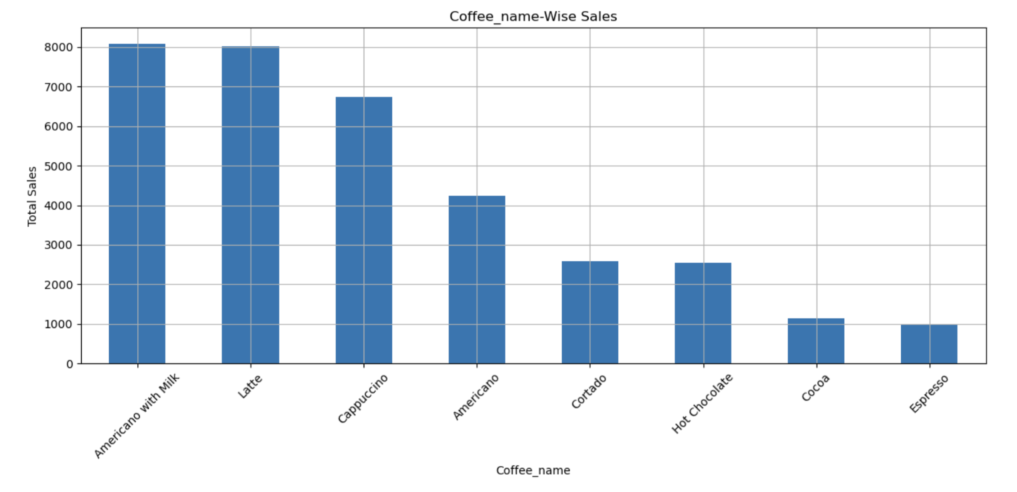
Bar Graph :
Bar graph of Coffee-name-wise Sales
EXPLANATION
>> After plotting the graph, we observed that the highest sales value contribution is made by “Americano with milk’ closely followed by ‘Latte’ and then by ‘Cappuccino’, ‘Americano’, ‘Cortado’, ‘Hot Chocolate’, ‘Cocoa’ and ‘Espresso’ in that order.
The graph gives an idea of the customer preferences which can be understood better by analysing the customer-wise coffee-name preferences and the count of coffee-name-wise sales.

Slide 16
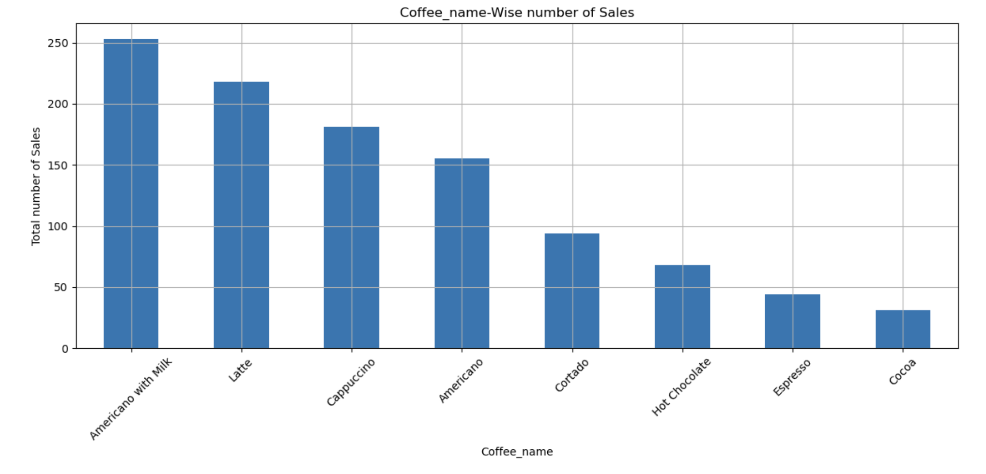
Bar Graph :
Bar graph of Coffee-name-wise number of Sales
EXPLANATION
>> After plotting the graph, we observed that the highest number of sales contribution is made by “Americano with milk’ followed by ‘Latte’ and then by ‘Cappuccino’, ‘Americano’, ‘Cortado’, ‘Hot Chocolate’, ‘Espresso’ and ‘Cocoa’ in that order.
The price of ‘Latte’ being a tad higher than ‘Americano with milk’, value wise although the ‘Latte’ comes close but number of sales-wise there is a distinct gap. Similarly, the price of ‘Cocoa’ being a higher than ‘Espresso’, value wise although the ‘Espresso’ comes after ‘Cocoa’ however, on-the-basis-of number of sales-wise the order is reversed.

Slide 17
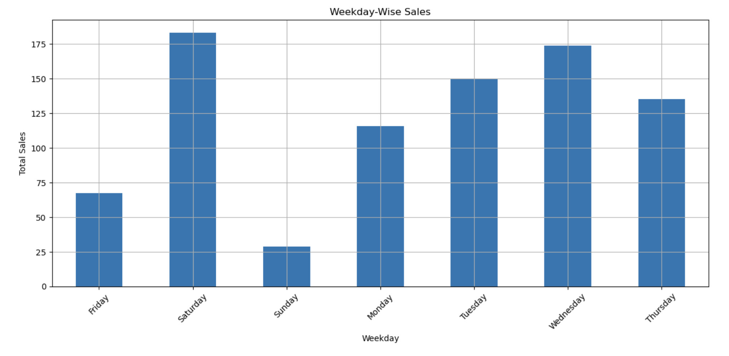
Bar Graph :
Bar graph of Weekday-wise Sales
EXPLANATION
>> After plotting the graph for a sample period of 15th March to 21st March 2024, we observed that the highest sales value-wise was made on “Saturday’ closely followed by ‘Wednesday’ and then by ‘Tuesday’, ‘Thursday’, ‘Monday’, ‘Friday’ and ‘Sunday’ in that order.
The graph gives an idea of the days on which the sales are more. The reasons for variation which is apparently large can be understood better by analysing other parameters

Slide 18
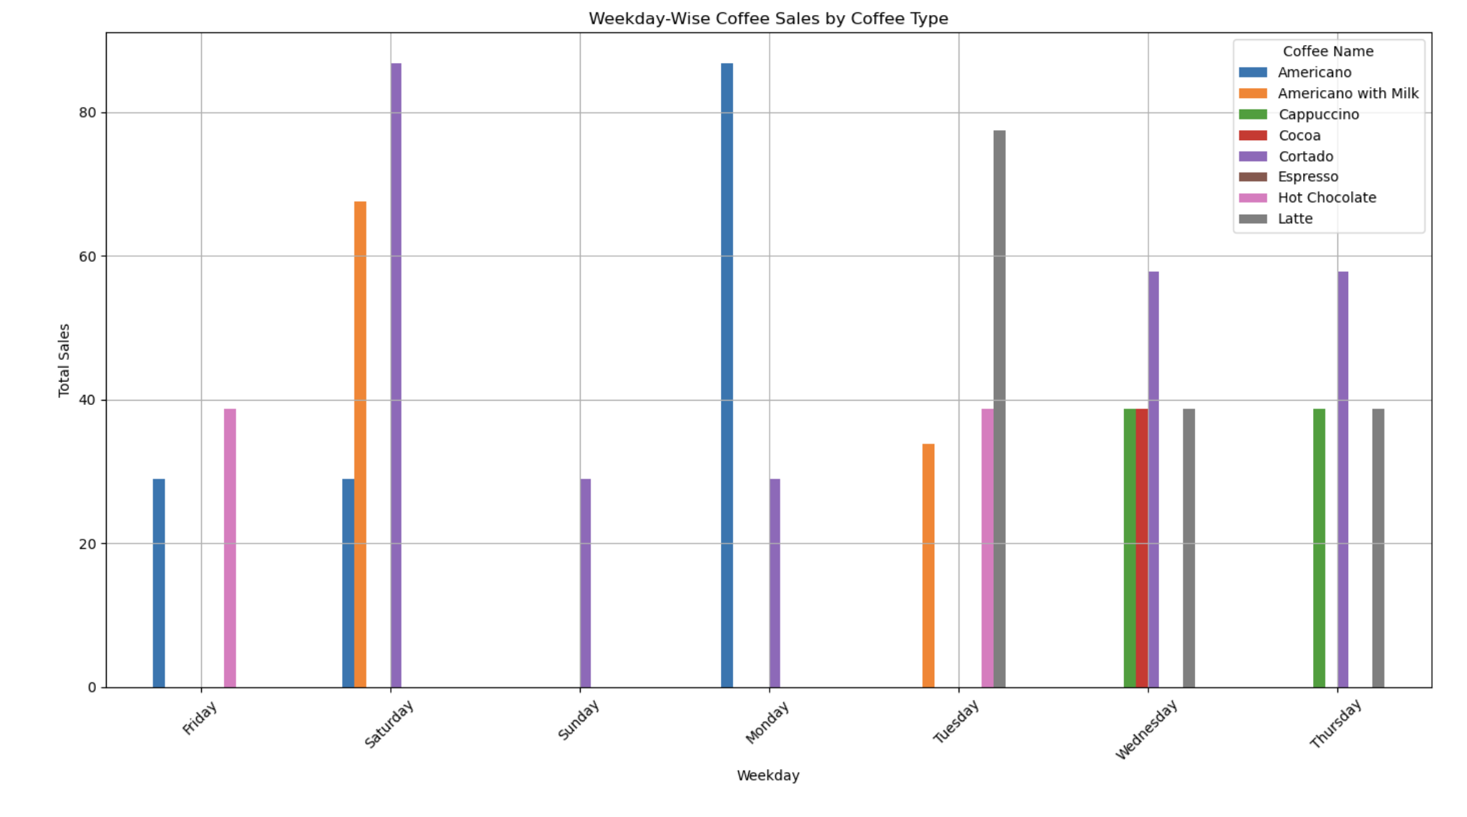
Bar Graph :
Bar graph of Weekday-wise Sales by Coffee type
EXPLANATION
>> After plotting the graph for a sample period of 15th March to 21st March 2024, we observed that the day-wise preferences varies as the highest number of sales contribution is made by Americano on Monday while it is by Cotrado on Saturday. And on Tuesday is Latte.
The graph gives an idea of the days on which the sales are more for a particular type of coffee. The reasons for variation can be understood better by analysing other parameters.

Slide 19
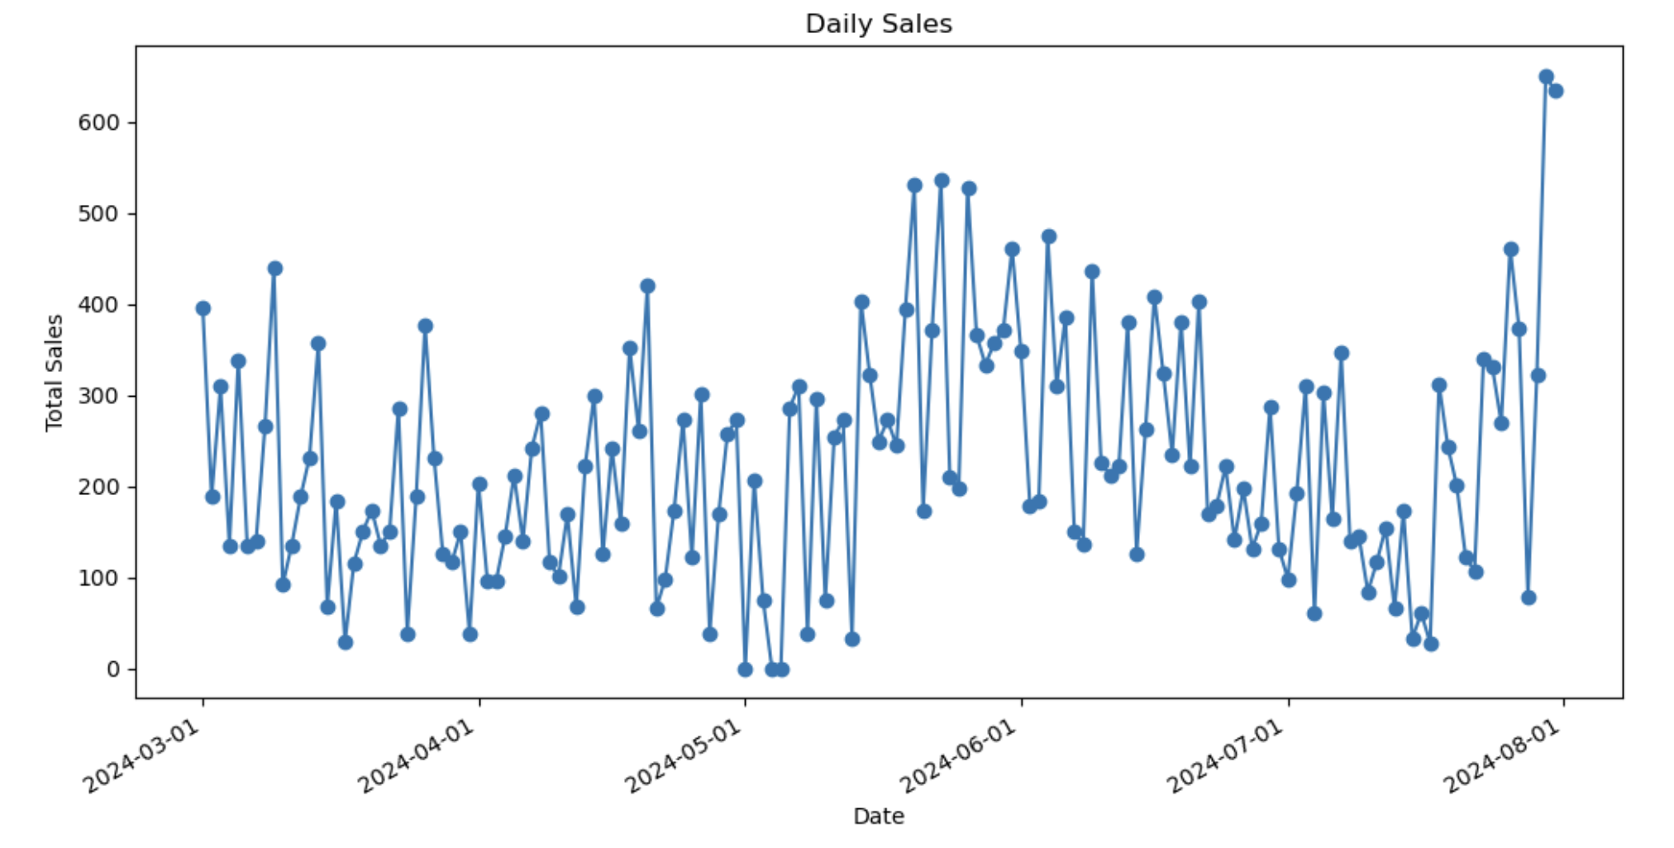
Line Graphs:
Line graph of Sales Vs Dates​
EXPLANATION
>> On observing the line plot chart, we see that it is non-linear and there is lot of variation in daily sales over the various dates. While the maximum sales on a day has been 650 (approx.), the minimum sales has been almost zero.

Slide 20
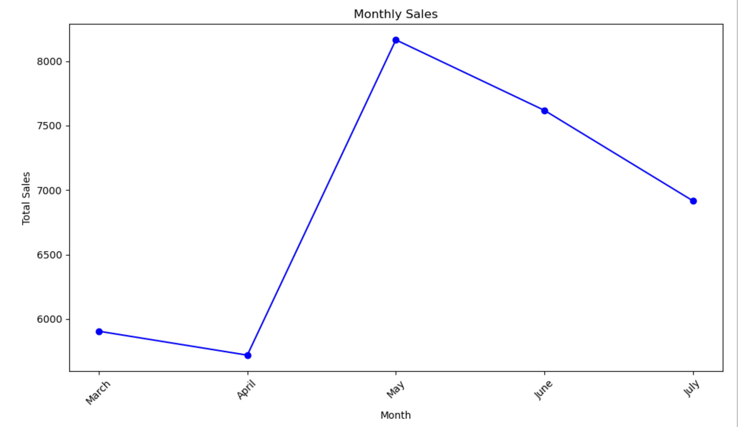
Line Graphs:
Line graph of Sales Vs Month
EXPLANATION
>> On observing the line plot chart, we see that it is non-linear and there is lot of variation in monthly sales during various months. While the maximum sales has been in the month of May 24, the minimum sales has been in April 24

Slide 21
Section 3

Slide 22
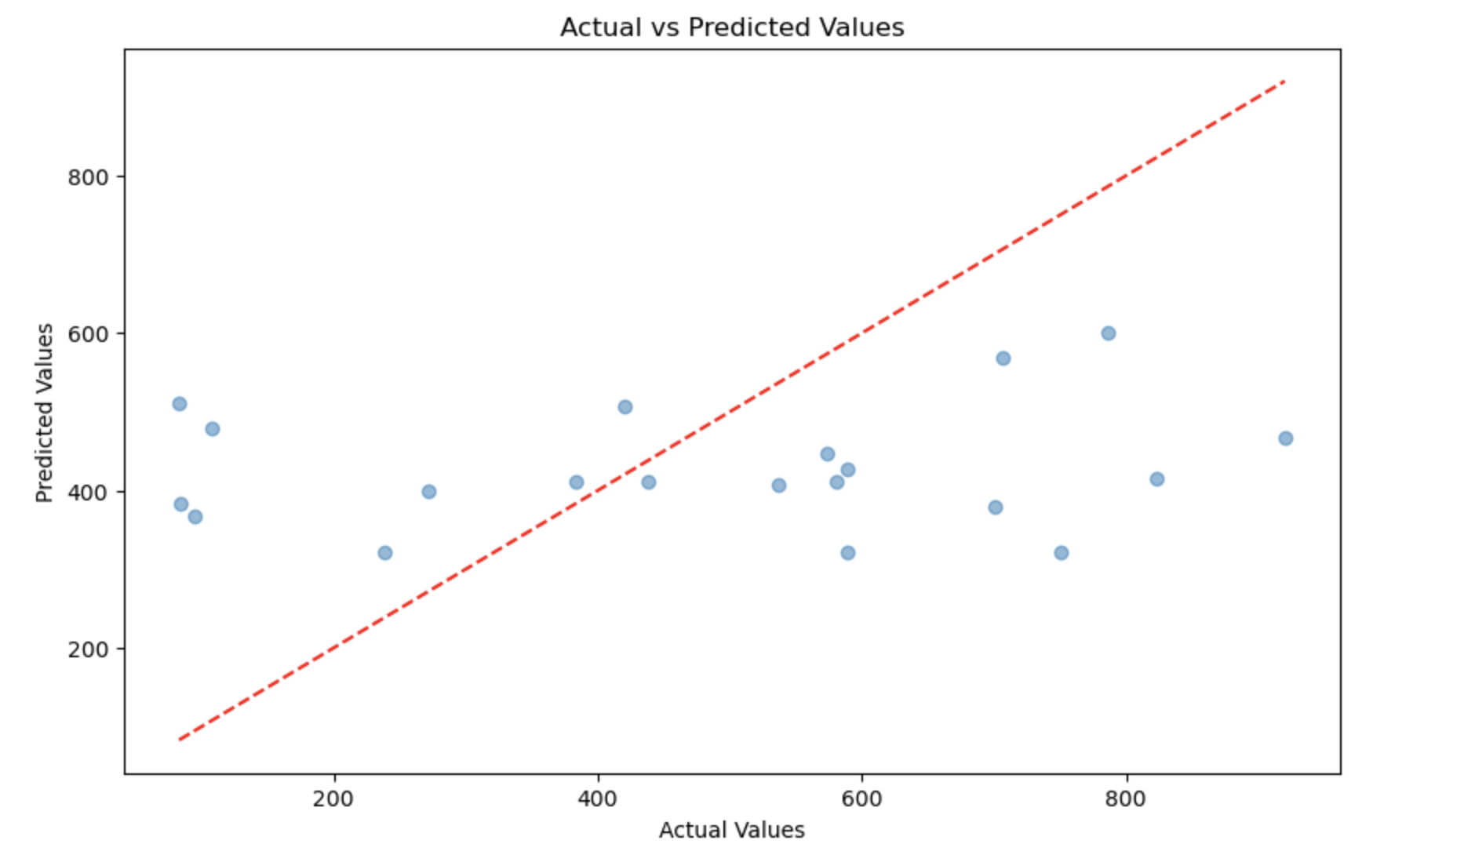
Scatter Graphs:
Scatter graph of Actuals Vs Predicted values​ for Next Day/Week/Month Sales
EXPLANATION
>> On observing the graph, drawn after applying the linear regression model in respect of the sales prediction for next day/week/month, we see that the points in the graph do not follow any specific pattern giving ground to a thought that the model is not a good fit.

Slide 23
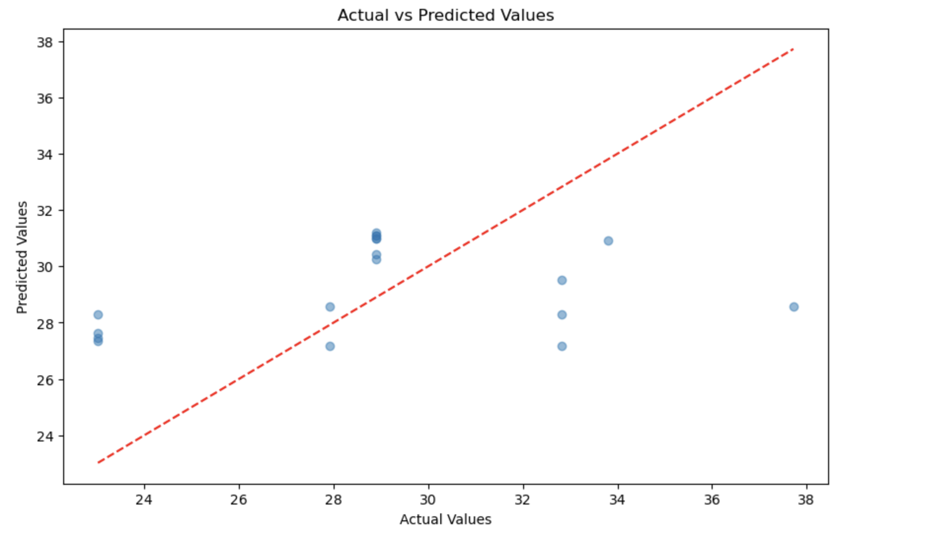
Scatter Graphs:
Scatter graph of Actuals Vs Predicted values​ for Specific Customer Purchase
EXPLANATION
>> On observing the graph, drawn after applying the linear regression model in respect of the specific customer-wise sales prediction for any day-of-the-week/month, we see that the points in the graph do not follow any specific pattern giving ground to a thought that the model is not a good fit.

Slide 24
Conclusions
At the beginning of the project, we defined the tasks that were to be performed. The tasks are :
Task - 1
Carry out Time series Exploratory Data Analysis
Task - 2
Predict Next day/week/month sales
Task - 3
Predict Specific customer purchases

Slide 25
Conclusions contd/-
Task - 1 : Carry out Time series Exploratory Data Analysis
After filtering the data for a date range, the plot for time series EDA was generated which gave the following inferences :
i. Line graph Sales Vs Date : >> On observing the line plot chart, we see that it is non-linear and there is lot of variation in daily sales over the various dates. While the maximum sales on a day has been 650 (approx.), the minimum sales has been almost zero.
ii. Line graph Sales Vs Month : >> On observing the line plot chart, we see that it is non-linear and there is lot of variation in monthly sales during various months. While the maximum sales has been in the month of May 24, the minimum sales has been in April 24
Task - 2 : Predict Next day/week/month sales
Linear regression model was used to predict the Next day/week/month sales. While testing the model following scores were obtained.
Mean Squared Error: 69407.99889353088 : Root Mean Squared Error: 263.4539787012731

Slide 26
Conclusions contd/-
Task - 2
To validate the MSE, RMSE cross validation was done and the Cross-Validated Mean Squared Error: 88468.19880590809 was obtained.
Graph of Residuals Vs Predicted Values and Actuals Vs Predicted Values were drawn.
The conclusion was that :
Model Performance: The RMSE and MSE values are quite high. This suggests that the model might not be providing accurate predictions. Whether these errors are large depends on the scale of your target variable.
Overfitting: The higher cross-validated MSE compared to the test set MSE suggests potential overfitting. The model performs better on the training set but struggles with unseen data.
Therefore, there is a felt need for feature engineering or adding additional features for evaluation and use of advanced models.

Slide 27
Conclusions contd/-
Task - 3 : Predict Specific Customer Purchases
Linear regression model was used to predict Specific Customer Purchases. While testing the model following scores were obtained.
Mean Absolute Error. : 3.2979651618634684 : Mean Squared Error. : 15.105314203785857 R² Score : 0.05631106598588986
To validate the MSE cross validation was done and the Cross-Validated MSE: 20.118520441120474 was obtained.
Graph of Residuals Vs Predicted Values and Actuals Vs Predicted Values were drawn.
The conclusion was that :
Model Performance: The MSE values is high. This suggests that the model might not be providing accurate predictions. Whether these errors are large depends on the scale of target variable.
Overfitting: The higher cross-validated MSE compared to the test set MSE suggests potential overfitting. The model performs better on the training set but struggles with unseen data.
Therefore, there is a felt need for feature engineering or adding additional features for evaluation and use of advanced models.

Slide 28
THANK YOU

